Slide 1
Introduction to Database Processing

Slide 2
Why Use A Database?
The purpose of a database is to help people and organizations keep track of things
Problems of using list to store data
Data inconsistencies
Data privacy: The departments want to share some, but not all, of their data
Databases store data in single-theme tables
Tables are related through primary and foreign keys

Slide 3
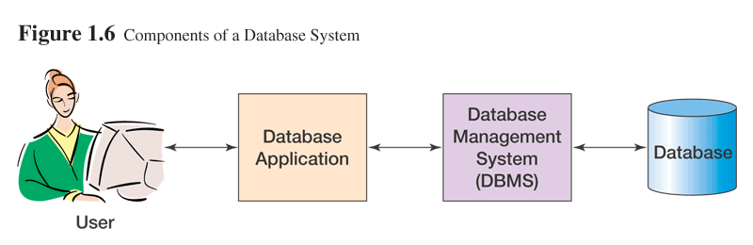
Components of A Database System

Slide 4
Application Programs
Functions:
Create and process forms
Create and transmit queries
Create and process reports
Execute application logic
Control application

Slide 5
DBMS
DBMS: Database Management System
Functions:
Create database, tables, and supporting structures
Read and update database data
Maintain database structures
Enforce rules
Control concurrency
Provide security
Perform backup and recovery
Example: Oracle, DB2, Microsoft Access, SQL Server

Slide 6
Database
Database is a self-describing collection of related records or tables
Components:
User Data
Metadata: data about the structure of a database
Indexes and related structures
Stored procedures: program modules stored within the database
Triggers: a procedure that is executed when a particular data activity occurs
Application metadata: data describing application elements such as forms and reports

Slide 7
Types of Database
Personal database
1 user; < 10 MB
Workgroup database
< 25 users; < 100 MB
Organizational database
Hundreds to thousands users
>1 Trillion bytes, possibly several databases

Slide 8
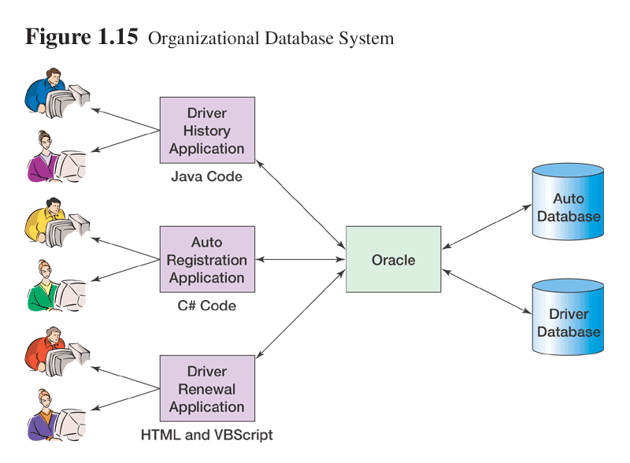
Example: Organizational Database

Slide 9
Building a Database System
3 Phases
Requirements phase: a data model is developed
Data model is a logical representation of the database structure
Design phase: the data model is transformed into tables and relationships
Implementation phase:
Tables, relationships, and constraints are created
Stored procedures and triggers are written
The database is filled and systems are tested
Database and its applications will be modified (through these same three phases) to meet new requirements

Slide 10
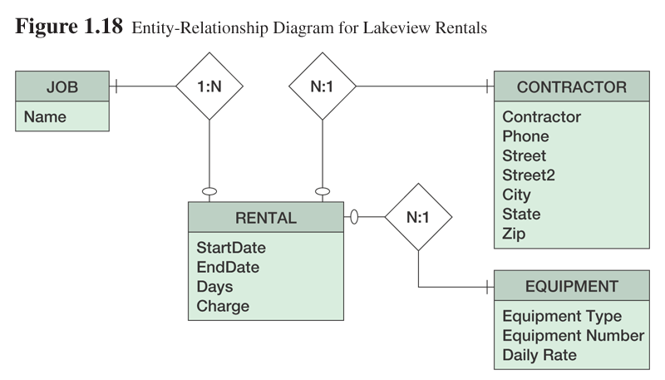
Example: Data Model

Slide 11
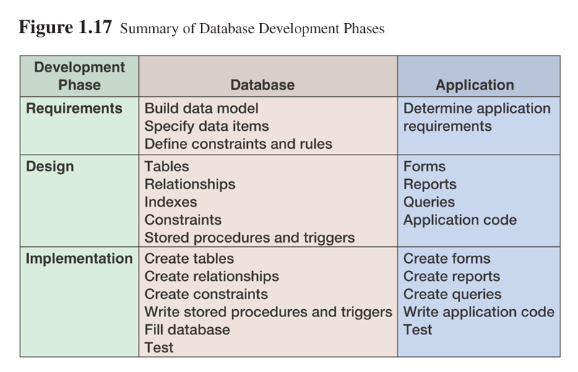
Application Development
Application development proceeds in parallel with database development

Slide 12
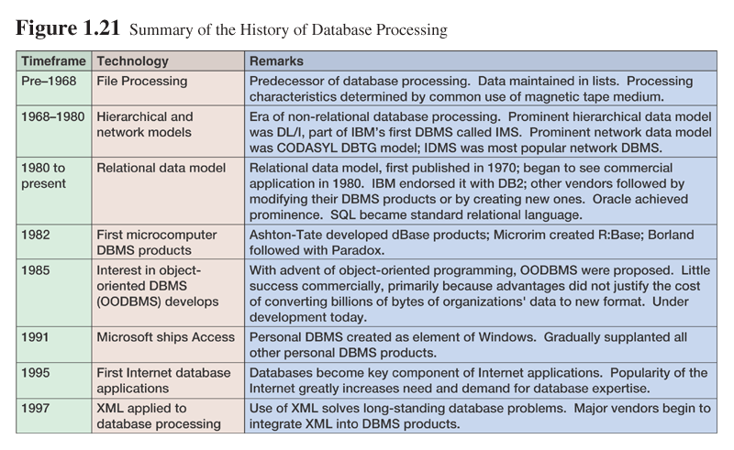
History of Database Processing

Slide 13
Early Database Models
Before mid-1960s, only sequential file processing using magnetic tape was possible
In mid-1960s, disk storage enabled hierarchical and network database
IBM’s DL/I (Data Language One)
CODAYSL’s DBTG (Data Base Task Group) model → the basis of current DBMSs

Slide 14
The Relational Model
E.F. Codd introduced the relational model in 1970
DB2 from IBM is the first DBMS product based on the relational model
Other DBMS based on the relational model were developed in the late 1980s
Today, DB2, Oracle, and SQL Server are the most prominent commercial DBMS products based on the relational model

Slide 15
Personal Computer DBMS
The advent of microcomputer increases popularity of personal databases
Graphical User Interface (GUI) make it easy to use
Examples of early DBMS products: dBase, R:base, and Paradox

Slide 16
Object Oriented DBMS (OODBMS)
Object-oriented programming started in the mid-1980s
Goal of OODBMS is to store object-oriented programming objects in a database without having to transform them into relational format
Object-relational DBMS products, such as Oracle 8i and 9i, allow both relational and object views of data on the same database
Currently, OODBMS have not been a commercial success due to high cost of relational to object-oriented transformation

Slide 17
Recent History
Success story of the Microsoft Access
Microsoft Office suite and Windows integration
Easy-to-use and powerful personal DBMS
Internet database
XML and database integration

Slide 18
E-R Modelling (Also known as Logical Data Structures)
Describe data as entities, relationships and attributes.
Introduced by Peter Chen in 1976
No single, standardized E-R model, but a set of common constructs.
The whole purpose of ER modelling is to create an accurate reflection of the real world in a database. The ER model doesn’t actually give us a database description. It gives us anintermediate step from which it is easy to define a database.

Slide 19
ER Model Concepts/Components of a Entity Relationship Diagram
The basic object that the E-R model represents is an entity
1. An entity
o A thing that exists in the real world with an independent existence and is distinguishable
An entity is a person, place, concept, or thing about which the business needs data.
o An entity is an object of interest to the organisation, i.e. anything about which data needs
to be stored.
An entity is something of importance to the system, about which data is held. The "something" in general
is the entity type, and each particular "something" is an occurrence of an entity type. For example Student
is an entity type while a student John Dube is a particular occurrence of the entity type Student. Department
is the name of one entity type. The Marketing division is an instance of the Division entity type.
An entity type defines a set of entities that have the same attributes though each entity has its own value(s)
for each attribute.
An entity type can either have physical existence or represent obvious physical things or conceptual
(covering concepts), for example a Student, Customer, a car, a house, an employee, and etc entities are
physical whilst a Project, a plan, a schedule, a course, an account, a job are conceptual entities. Others may
represent transactions, e.g. Orders, Sales, and Hospital Admissions
Entity class = entity set = entity type
o Collection of entities of the same type
The general description of a thing (ex. EMPLOYEE, PROJECT)

Slide 20
Hints for identifying entities
Entities are representations of data that is being stored. So if a DFD has been drawn, check, there should be
an entity corresponding to each data store or file on the DFD.
1. Think about what groupings of data the user is going to want to see. Remember that a grouping
may only be a subset of the entire entity.
2. An entity is something we are going to hold data about so try and group the data items into logical
groupings of data. When doing this do not show data items in more than one table.
By entity we mean something in our system about which we need to hold information. An entity must have
the following characteristics:
1. It must contain information of interest to the system i.e. the STUDENT entity contains
information concerning names, addresses, qualifications, exam results etc.;
2. It must be possible to have more than one occurrence i.e. the environment itself cannot be an
entity as there is only one occurrence;
3. Each occurrence must be uniquely identifiable - there must be a code or key for each entity
instance.
Different classifications of entity include:
. Tangible e.g. Person, Product, Car
. Conceptual e.g. Course Title, Account, Job
. Active e.g. Delivery, Payment, Sale
. Permanent e.g. Warehouse
. Volatile e.g. Stock

Slide 21
2. Entity Attributes (properties)
Contains the relevant information of an entity. An entity contains the structuring information and attributes
are the describing information. These are the data items associated with each entity, (another way to think
of them is record fields, similarly entities can be looked at as records).
Eg for an entity type Employee the attributes may be
. Name:
. Address:
. DOB:
Attributes have four functions:
- Description of the entity’s characteristics.
- Identification
- reference (relation between entities)
- classification
An attribute-value is the atomar information itself. It can be null (null-value), then it is called a not
obligatory attribute, or it must have a value, then it is an obligatory attribute.
The attributes of an entity are the data items that describe the properties of the entity StudentName,
StudentAddress, only record attributes that are of significance to the organization.
The value of an attribute is the value of that attribute for a particular entity occurrence
“John Browne” is the value of StudentName attribute.

Slide 22
All entities of a given type have attributes in common:
. Values of an attribute are drawn from some specified Domain;
. Key attributes provide a unique key for the instance of an entity type;
. Attributes can be atomic or composite properties of entities, e.g. the composite attribute 'customer
name' may be made up of 'first name', 'last name', 'initial';
. Values of attributes may be single or multiple, e.g. repeating groups are permitted;
. Values of attributes may be null, e.g. N/A or unknown.
o All instances of a given entity class/ type have the same attributes
o Four types of attributes
1. Single valued: max. Cardinality is 1 (like single variable)
2. Multiple valued: max. Cardinality > 1 (like arrays)
3. Composite: like records (ex. Address = {Street, City, State, Zip})
4. Derived attributes eg age

Slide 23
Key Attribute
. An attribute or set of attributes whose values uniquely identify each entity in an entity set or an
attribute that is used to identify each entity from all the others in the entity type. In some cases you
might need more than one attribute in the primary key to identify the entities.
Apart from serving as an identifier for each entity within an entity type, the primary key also serves as the
method of representing relationships between entities. The primary key becomes a foreign key in all those
entity types to which it is related in a one-one or one-many relationship type.
Each entity occurrence must be able to be uniquely identified, and this unique identifier will give us access
to all the data items associated with it.
Attributes can be shown on the entity-relationship diagram in an oval. It is up to you which attributes you
show on the diagram.

Slide 24
Relationships
Determining the relationships among entity types is another important step in the process of ER modelling.
A relationship is a link or an association between two entities, which is meaningful for the organisation.
e.g. A Customer ‘places’ an Order. Employee manages department.
Relationships usually arise because of association - a Customer ‘places’ an Order
Structure - an Order ‘consists’ of Order-Lines. Relationships trace the access from one entity to another e.g.
finds the orders placed by a customer
. A relationship among entities: an ordered list of entity sets
REL among E1, E2, ... Ek => set of k-tuples (e1, .., ek) ( entities e1 is in class E1, .....)
. Relationship class: association among entity classes
. Relationship instance: association among entity instances
. Degree of relationship: the number of entities in a relationship

Slide 25
A relationship’s cardinality defines the maximum number of entities of one type that can be associated with an entity of another type.
One-to-one relationship - any occurrence of the first entity is related to one and only one occurrence
of the second entity
e.g. Husband and Wife, Module and Syllabus
One to many relationship - any occurrence of the first entity is related to one or more occurrences of
the second entity
e.g. Customer and Order, Course and Student
Many to many relationship - two entities are related to each other by one to many relationships
e.g. Musician and Concert, Course and Lecturer
Reflexive relationship - an occurrence of an entity is related to other occurrences of the same entity
e.g. “manages” relationship, “parent” relationship
Binary relationship: relationship of degree 2.

Slide 26
The role of the entity model
1. During Part 1, Analysis of the current system, the production of the data store/entity cross reference
identifies the entities that correspond to each physical data store. This information
is used to create the current logical data flow diagrams.
2. The data store/entity cross-reference may highlight certain problems, e.g. duplication of
physical files.
3. During Part 2, Specification of Requirements, the required logical data flow diagrams and
the entity model are analysed to produce the entity/function matrix.
4. During Part 3, Logical Data Design, the entity model is compared with the normalised data
structures and any discrepancies are sorted out.
5. During Part 4, Logical Process Design, the logical process outlines are cross-referenced to
the entities in the entity model.
6. During Part 5, Physical Design, the entity model, the entity descriptions and the logical
process outlines are used to specify the physical files which may be a database or a non database
solution and the target hardware.

Slide 27
Constraints
Two Structural Constraints on Relationship Types
Main type of constraint on relationships is called multiplicity.
Multiplicity - number (or range) of possible occurrences of an entity type that may relate to a single
occurrence of an associated entity type through a particular relationship.
. Cardinality Ratio Constraints – specifies the number of relationship instances that an entity can
participate in.
o 1:1 one-to-one
o 1:N or N:1 one-to-many
o M:N many-to-many
. Participation Constraints- specifies whether the existence of an entity depends on its being related to
another entity via the relationship type.
o Total Participation (or Existence Dependency)
o Partial Participation
Represents policies (called business rules) established by user or company

Slide 28
Weak Entity Types
Weak Entity Type: An entity type E such that E has no key attribute and entities in E are uniquely
identified by a relationship type R between E and another entity type E' together with some of the attributes
of the entity type.
Identifying Owner E'
Identifying Relationship R
Partial Key: The set of attributes of E' that can uniquely identify all the entities in a weak entity type
which are related to the same entity in the identifying owner
Example
-------
EMPLOYEE and DEPENDENT
Two distinct entities in DEPENDENT may have exactly the same attribute values, although they are
distinguished by their relationships with entities (i.e., employees) in EMPLOYEE such that who supports
which dependent.

Slide 29
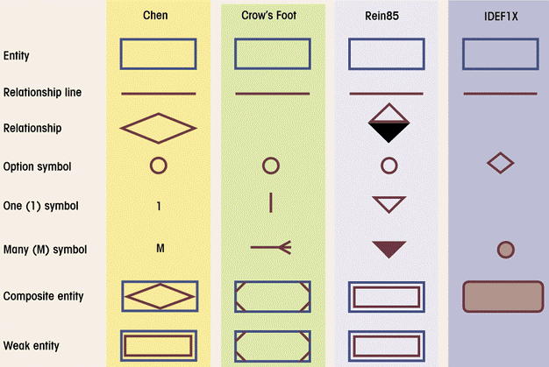
ER Diagram Notation

Slide 30
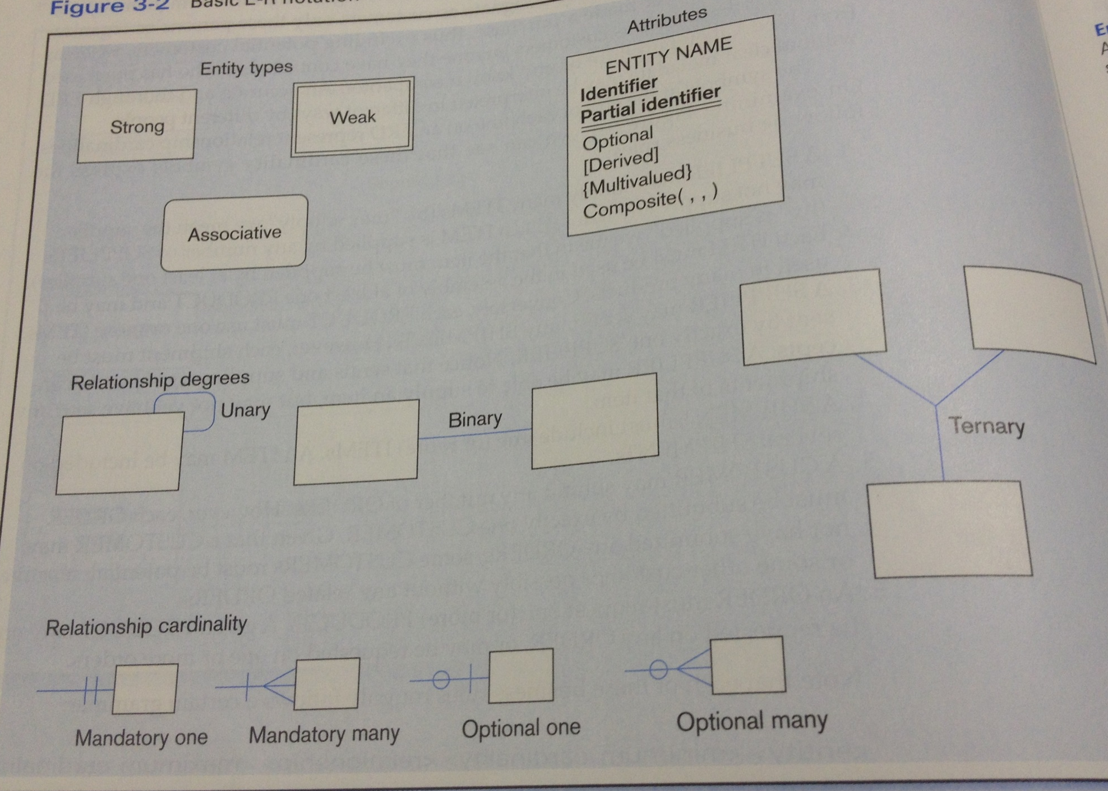

Slide 31
Potential problems with E-R models
Not being able to represent complex situations.
Entity relationship (ER) approach is predominantly used for conceptual modelling of database systems in
terms of entities and their relationships. The approach does not provide sufficient support for incorporating
business constraints and their impact on the entity relationships, thus leaving a gap between the
requirements elicitation and database implementation.
•Problems may arise when designing a conceptual data model called connection traps.
••Often due to a misinterpretation of the meaning of certain relationships.
••Two main types of connection traps are called fan traps and chasm traps.
•Fan Trap
–Where a model represents a relationship between entity types, but pathway between certain entity
occurrences is ambiguous.
–•Chasm Trap
–Where a model suggests the existence of a relationship between entity types, but pathway does not exist
between certain entity occurrences.

Slide 32
Enhanced E-R model Concepts
The EER model includes all modelling concepts of the E-R model and in additions includes concepts of
Specialisation, generalisation, inheritance, aggregation, subclass, superclass and category.
Consider an entity type employee in a company database, we then have subgroupings such as secretaries,
technicians etc. In this case the subgroup secretaries or technicians is a subclass of the employee entity
type hence employee becomes the superclass. So we can talk of a superclass/subclass relationship.

Slide 33
Use of Subclasses in Data modelling
Two main reasons for including class/subclass relationships in a data model:
- Certain attributes may apply to some but not all entities of the superclass entity type so a subclass
is defined in order to group the entities to which these attributes apply eg typing speed for
secretary.
- Some relationships types may be participated in only by entities that are mebers of the subclass.
Patient
Patient ID
Patient Name
Admit Date
Responsible Physician
Physician ID
Resident Patient
Date_Discharged
BED
Bed ID
Out Patient
Check back Date

Slide 34
Attribute Inheritance
A member of the subclass inherits properties/attributes of the entity as a member of the superclass. This is
basically because an entity in the subclass represents the same real-world entity from the superclass so it
should possess values for its specific attributes as well as values of its attributes as a member of the
superclass.

Slide 35
Specialisation
The process of defining a set of subclasses of an entity type and this entity type is called the superclass of
the specialisation. Alternatively specialisation can be thought of as the abstracting process of introducing
new characteristics to an existing class of objects to create one or more new classes of objects.Eg the set of
subclasses {secretary, technician, engineer} is a specialisation of the superclass Employee that
distinguishes among Employee entities based on the job type of each entity.
The Specialisation Process:
- define a set of subclasses of an entity type
- associate additional specific attributes with each subclass
- establish additional specific relationship types between each subclass and other entity types, or
other subclasses.

Slide 36
Generalisation
The abstracting process of viewing sets of objects as a single general class by concentrating on the general
characteristics of the constituent sets while suppressing or ignoring their differences. Generalisation is an
IS_A relationship eg manager IS_An employee. Student is a generalisation of graduate or undergraduate.
Car and truck are both examples of the generalised superclass Vehicle
Generalisation is considered as being functionally the inverse of the specialisation process.

Slide 37
Design Constraints on a
Specialization/Generalization (Contd.)
! Completeness constraint -- specifies whether or not an entity in
the higher-level entity set must belong to at least one of the
lower-level entity sets within a generalization.
" total : an entity must belong to one of the lower-level entity sets
" partial: an entity need not belong to one of the lower-level entity
sets

Slide 38
Vehicle
Vehicle ID
Price
Engine Displacement
Vehicle Name
Car
Vehicle ID
Price
Engine Displacement
Vehicle name
No of Passengers
Truck
Vehicle ID
Price
Engine Displacement
Vehicle name
No of Passengers
MotorCycle
Vehicle ID
Price
Engine Displacement
Vehicle name
No of Passengers

Slide 39
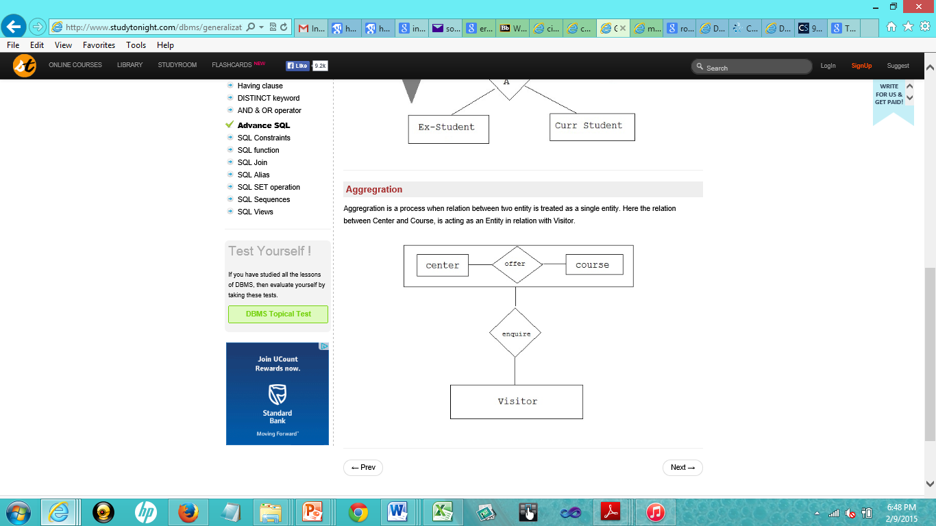
Aggregation

Slide 40
Aggregation (Cont.)
! Relationship sets works-on and manages represent overlapping
information
" Every manages relationship corresponds to a works-on relationship
" However, some works-on relationships may not correspond to any
manages relationships
# So we can’t discard the works-on relationship
! Eliminate this redundancy via aggregation
" Treat relationship as an abstract entity
" Allows relationships between relationships
" Abstraction of relationship into new entity
! Without introducing redundancy, the following diagram represents:
" An employee works on a particular job at a particular branch
" An employee, branch, job combination may have an associated manager

Slide 41
Question 1 What is the relationship among the following? List a few facts common to all items for each
Case. List a few facts about each subtype that is not common to the other subtype. Also draw the ER
diagram for each.
1. Book, publication, magazine
2. Individual, employee, contact person
3. Laptop, computer, desktop
Question 2 Suppose you are part of the team that has been tasked to design a database for a hospital
management system and you have the following information/clues:
- A hospital has a number wards
- Each ward has a number patients
- Patients have only one doctor allowed to prescribe drugs for them.
- Doctors do their rounds once a day and prescribe drugs by prescription to their patients
- A prescription identifies the drug by code and name, recommended dosage and length of treatment
Draw the E-R diagram for this database system.

